Slide 1
Special Theory of Relativity
Grade 12 Physics

Slide 2
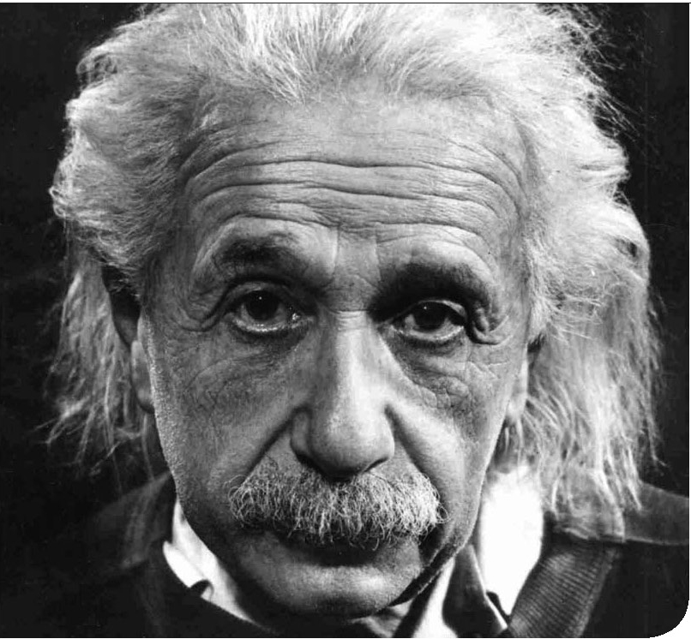
Special Theory of Relativity
Special Theory of Relativity
Albert Einstein

Slide 3
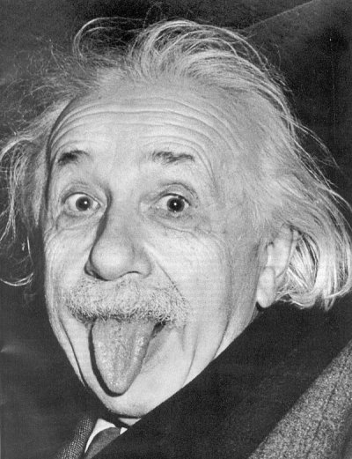
Special Theory of Relativity
Special Theory of Relativity
In 1921, Einstein was awarded for the 1921 Nobel Prize for Physics for his development of the concept of photons and the resulting explanation of the photoelectric effect, not for his theories of relativity.

Slide 4
Special Theory of Relativity
Special Theory of Relativity
What does the theory tell us?
Fundamental measurements such as time, distance, and mass depended on the relative motion of the observer.
WOOOW…That’s absurd.

Slide 5
Thought Experiments and Scenario
Consider the following
Two identical boats, X and Y, are about to travel in a stream. Boat Y will go Straight across the stream and straight back, Boat X will travel the same distance downstream and then return to its starting point. Which will make the trip in the shortest time?

Slide 6
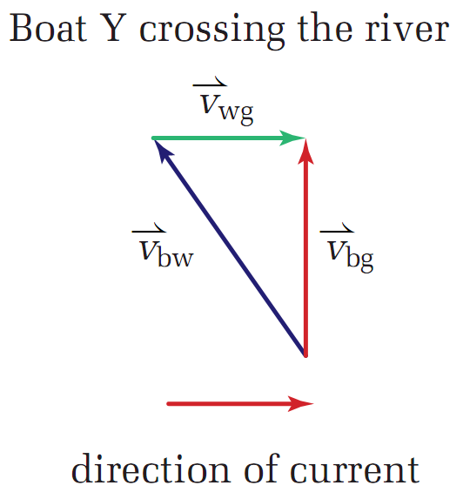
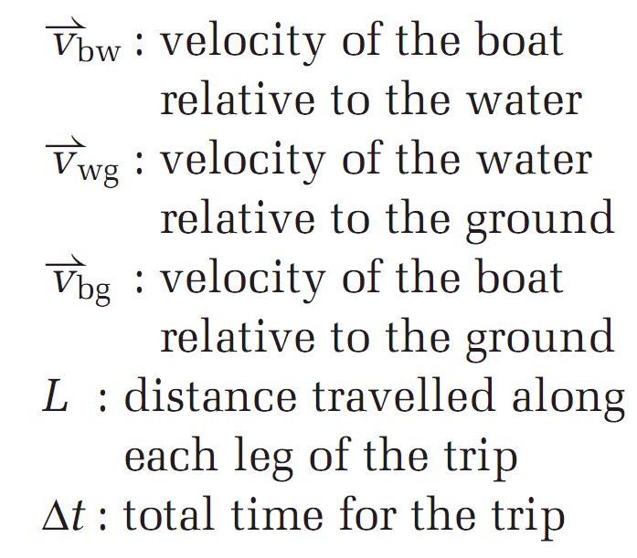
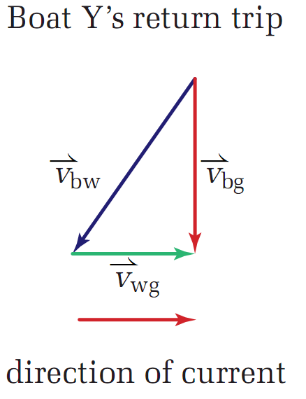
Thought Experiments and Scenario
Consider the following

Slide 7
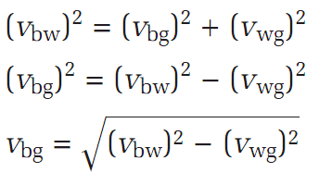
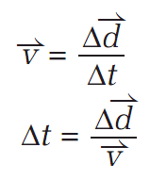
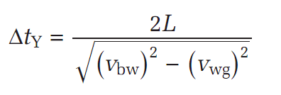
Thought Experiments and Scenario
Consider the following
Boat Y

Slide 8
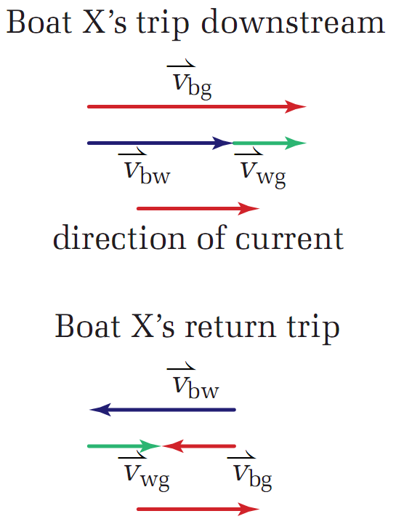

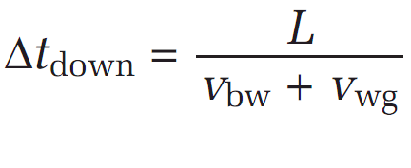
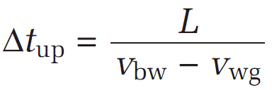

Thought Experiments and Scenario
Consider the following
Boat X

Slide 9
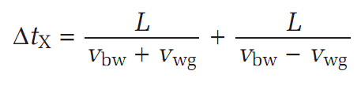
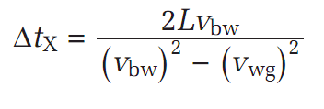
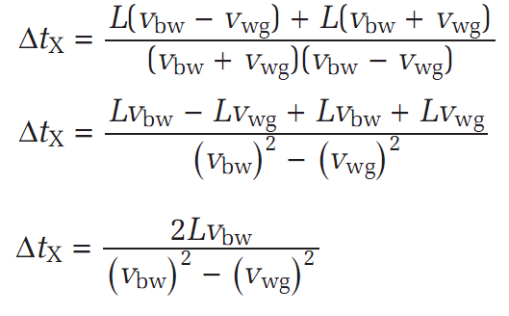
Thought Experiments and Scenario
Consider the following
Boat X

Slide 10
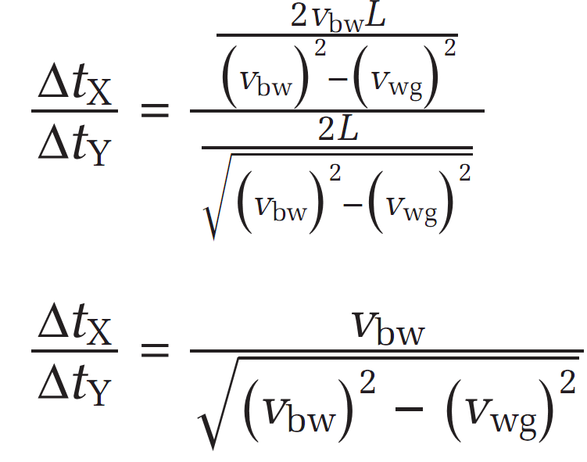
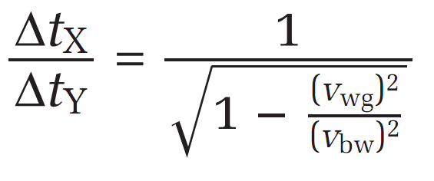
Thought Experiments and Scenario
Consider the following
Both Boats, Who is faster?

Slide 11
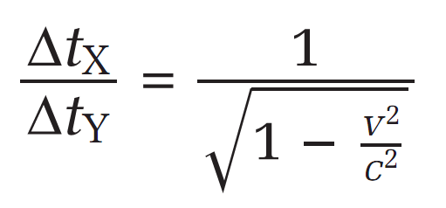
Thought Experiments and Scenario
Consider the following
What about Light?

Slide 12
Thought Experiment: Simultaneity
If you see two sets of fire works ignite at exactly the same time – one off to your left and the other far to your right. About 100m behind you, a car is travelling along a highway at 95km/h. Do the passengers in the car see the fire works igniting simultaneously or do they think that one set ignited before the other?

Slide 13
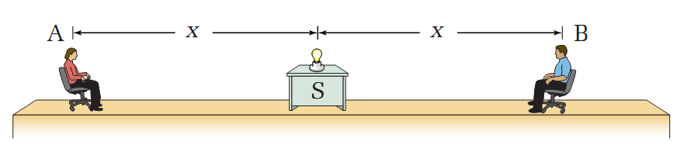
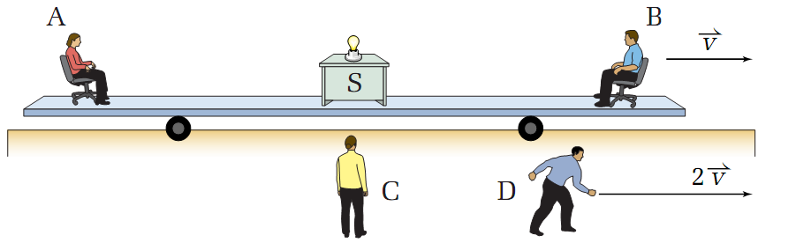
Thought Experiment: Simultaneity
How long it takes light to reach A and B?

Slide 14
Thought Experiment: Simultaneity
What does this represent?
Future to Past?
Past to Future?
WHAT?

Slide 15
Thought Experiment 2: Time Dilation
Let’s say we are back to watching the fireworks. Your look at your watch at the moment that the fireworks ignite and it says 11:23pm. What do the watches of the passengers in the car read? If they saw the fireworks ignite at different times, their watches cannot possibly agree with yours.

Slide 16
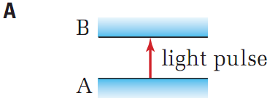
Thought Experiment 2: Time Dilation
Time Dilation
Applies to situations in which time intervals appear different to observers in different inertial frames of reference.

Slide 17
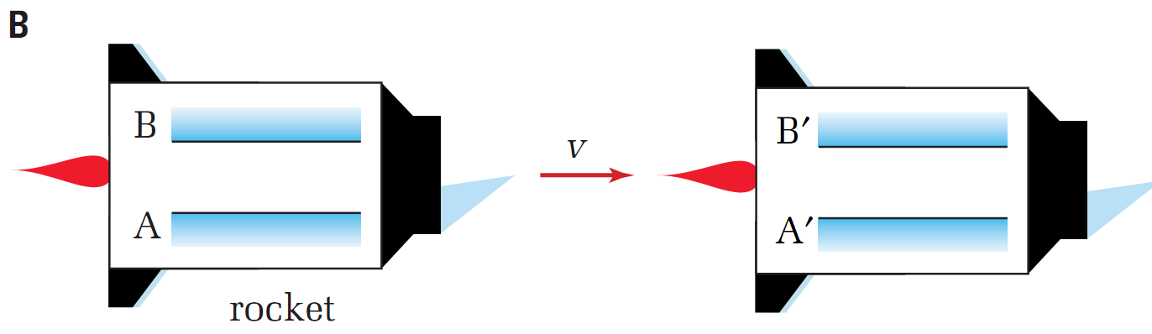
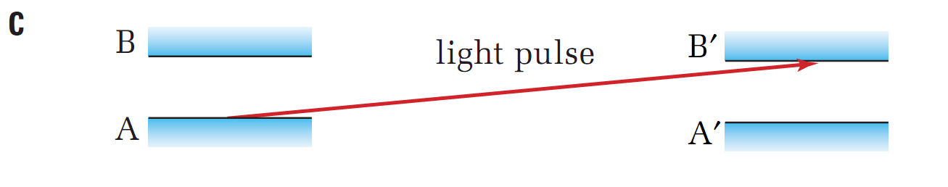
Thought Experiment 2: Time Dilation
Time Dilation

Slide 18
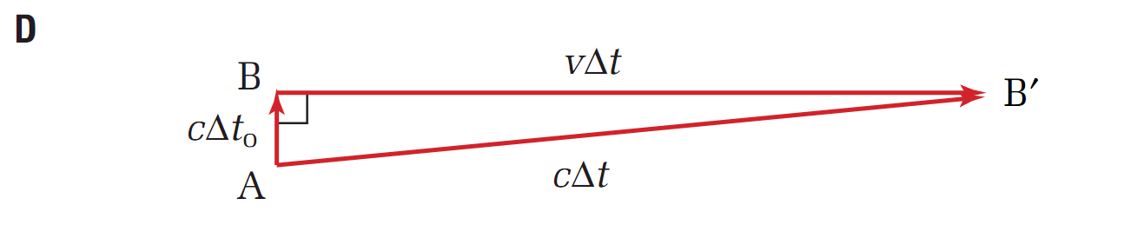
Thought Experiment 2: Time Dilation
Time Dilation

Slide 19
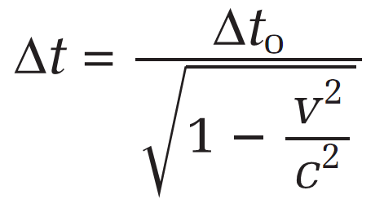
Thought Experiment 2: Time Dilation
Time Dilation

Slide 20
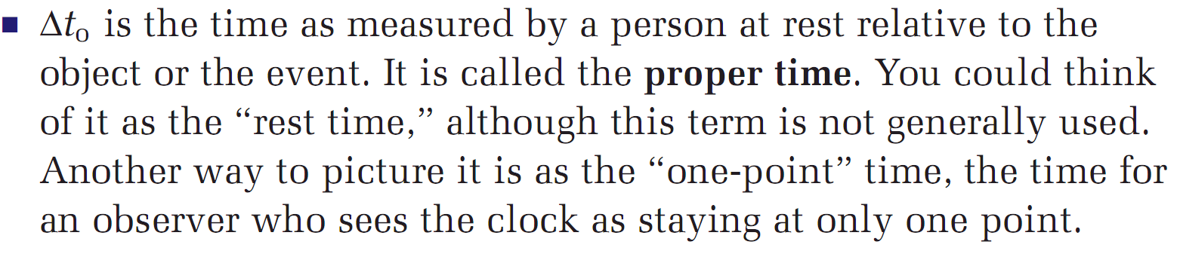
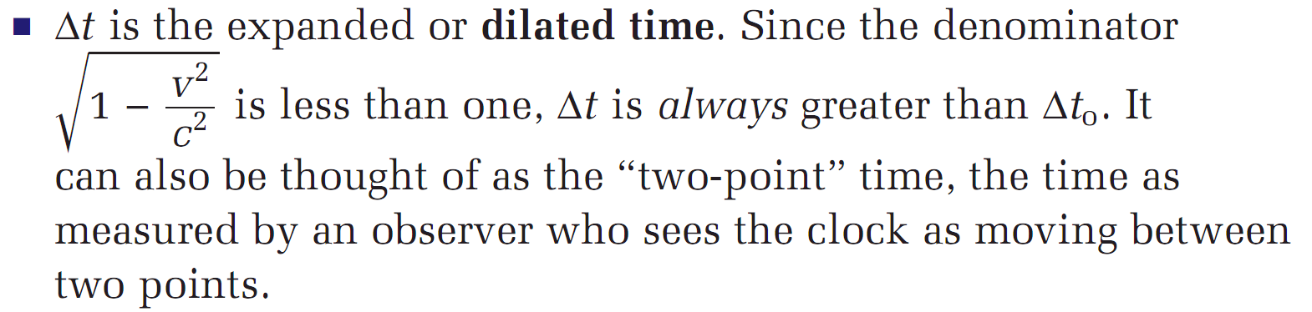
Thought Experiment 2: Time Dilation
Time Dilation

Slide 21
Example Problem
EX1:
A rocket speed past an asteroid at 0.800c. If an observer in the rocket see 10.0s pass on her watch, how long would that time interval be as see by an observer on the asteroid?

Slide 22
Thought Experiment: Length Contraction
Captain Quick is a comic book hero who can run at nearly the speed of light. In her hand, she is carrying a flare with a lit fuse set to explode in 1.50μs. The flare must be placed into its bracket before this happens. The distance (L) between the flare and the bracket is 402m.

Slide 23
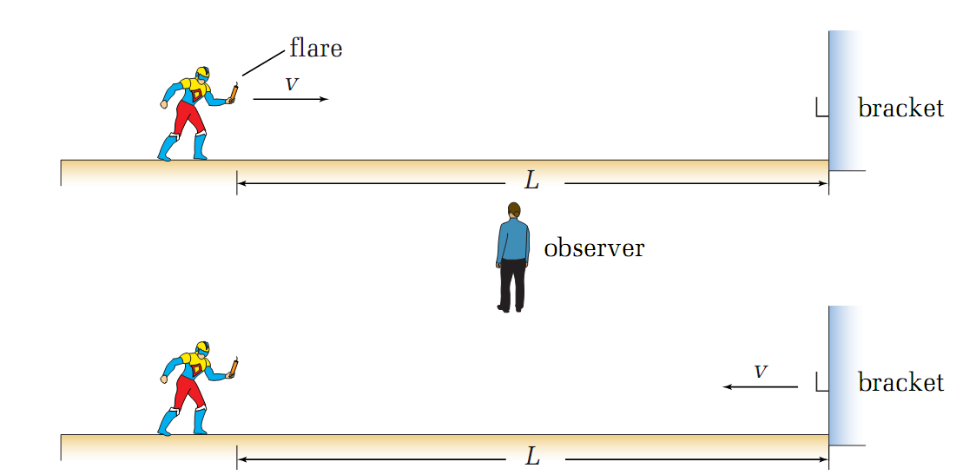
Thought Experiment: Length Contraction

Slide 24
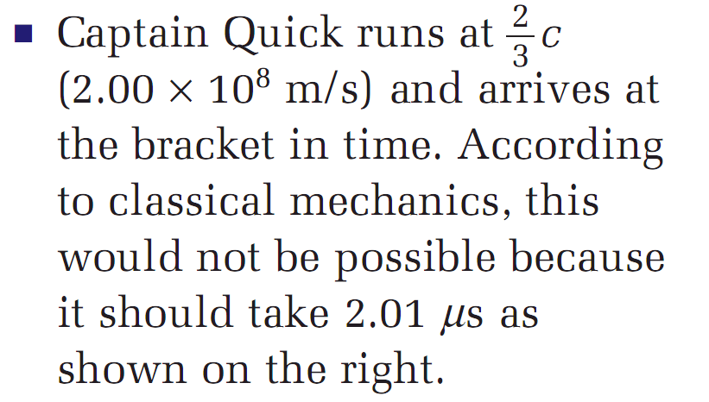
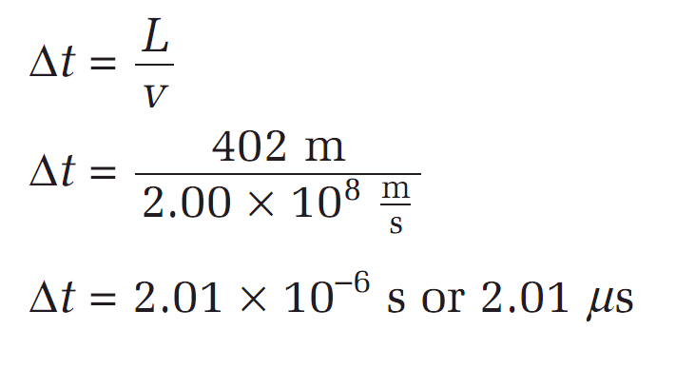
Thought Experiment: Length Contraction
Will he get there in time?
Classical Physics

Slide 25
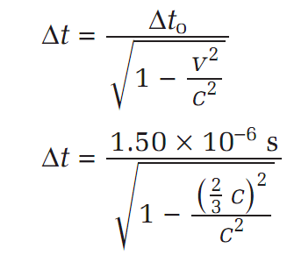
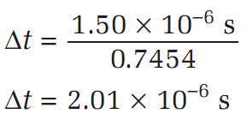
Thought Experiment: Length Contraction
Will he get there in time?
To an observer
The captain actually made it in time.

Slide 26
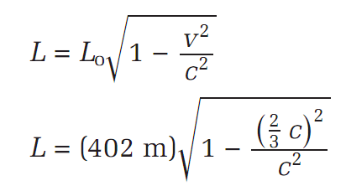
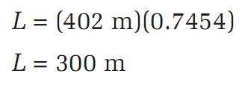
Thought Experiment: Length Contraction
How did she reach the bracket in time?
From the captains frame of reference the fuse burned in 1.50μs. How did she make it in time?
She isn’t travelling faster. The only possibility is then that the distance actually got shorter (In Her Moving Frame of Reference)

Slide 27
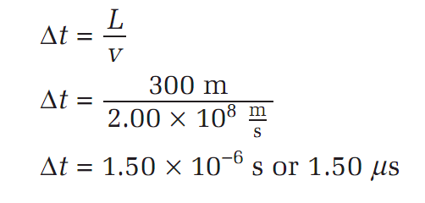
Thought Experiment: Length Contraction
How did she reach the bracket in time?
With the classical physics again.

Slide 28
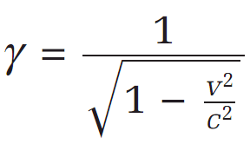

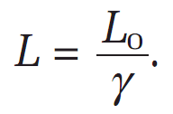
Gamma Saves Time
Relativistic Speeds:
Gamma is used simply for saving time and physicists been lazy

